Slide 1

Chapter 20
Poșta electronică:
SMTP, POP, IMAP
Objectives
Upon completion you will be able to:
Understand four configurations of email architecture
Understand the functions and formats of a user agent
Understand MIME and its capabilities and data types
Understand the functions and commands of an MTA
Understand the function of POP3 and IMAP4
TCP/IP Protocol Suite

Slide 2
20.1 ARCHITECTURE
To explain the architecture of email, we give four scenarios. We begin with the simplest situation and add complexity as we proceed. The fourth scenario is the most common in the exchange of email.
The topics discussed in this section include:
First Scenario
Second Scenario
Third Scenario
Fourth Scenario
TCP/IP Protocol Suite

Slide 3
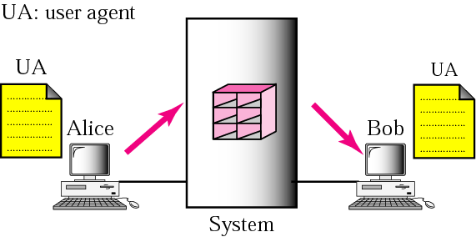
Figure 20.1 First scenario
TCP/IP Protocol Suite

Slide 4

Note:
When the sender and the receiver of an email are on the same system, we need only two user agents.
TCP/IP Protocol Suite

Slide 5
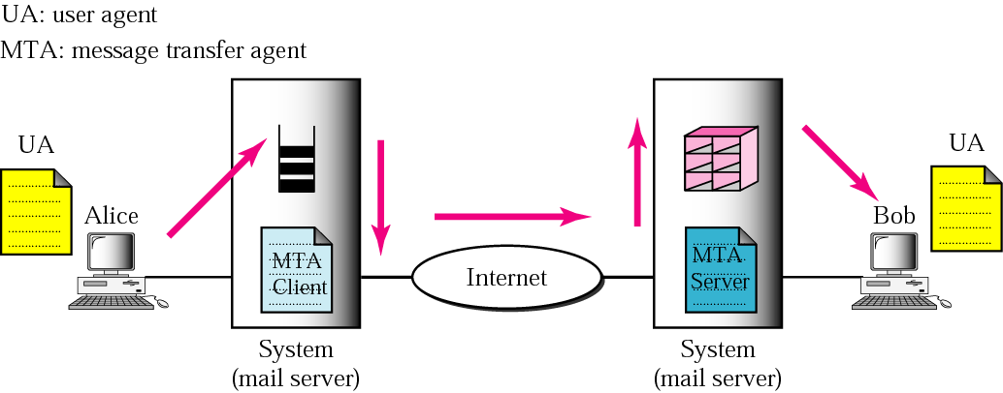
Figure 20.2 Second scenario
TCP/IP Protocol Suite

Slide 6
Note:
When the sender and the receiver of an email are on different systems, we need two UAs and a pair of MTAs (client and server).
TCP/IP Protocol Suite

Slide 7
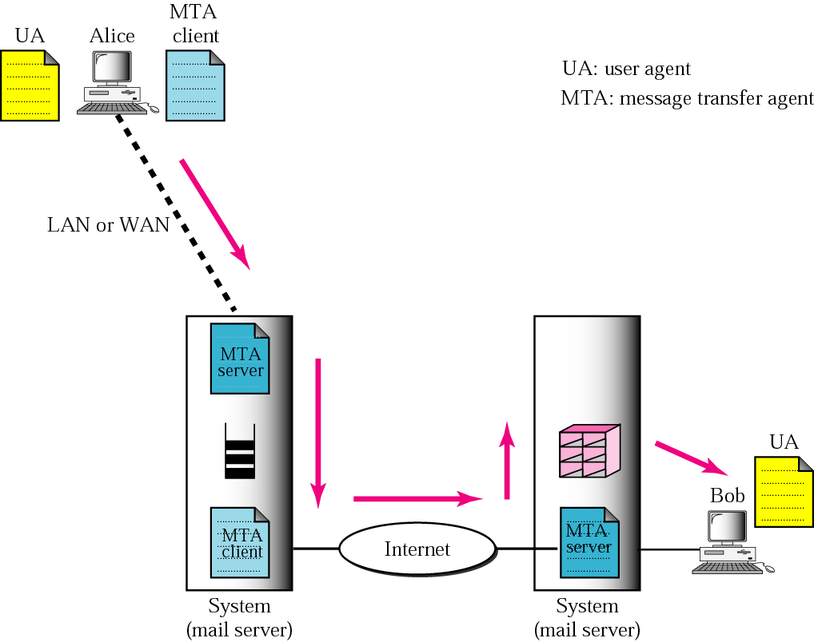
Figure 20.3 Third scenario
TCP/IP Protocol Suite

Slide 8
Note:
When the sender is connected to the mail server via a LAN or a WAN, we need two UAs and two pairs of MTAs (client and server).
TCP/IP Protocol Suite

Slide 9
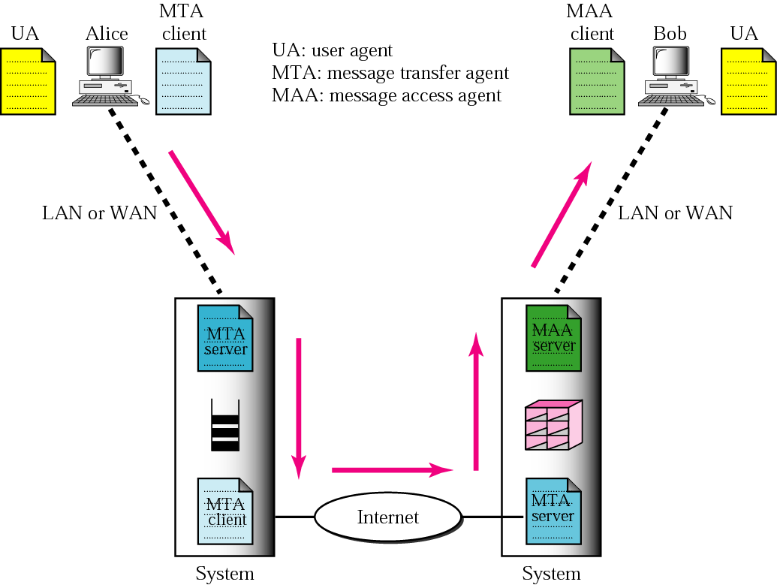
Figure 20.4 Fourth scenario
TCP/IP Protocol Suite

Slide 10
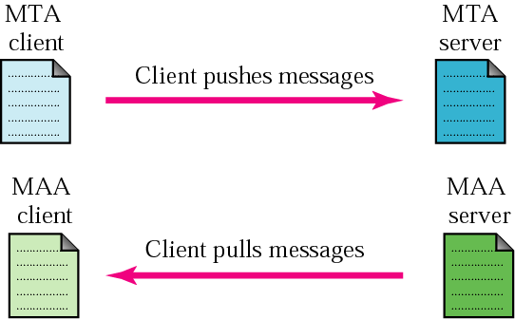
Figure 20.5 Push vs. pull
TCP/IP Protocol Suite

Slide 11
Note:
When both sender and receiver are connected to the mail server via a LAN or a WAN, we need two UAs, two pairs of MTAs (client and server), and a pair of MAAs (client and server). This is the most common situation today.
TCP/IP Protocol Suite

Slide 12
20.2 USER AGENT
The user agent (UA) provides service to the user to make the process of sending and receiving a message easier.
The topics discussed in this section include:
Services Provided by a User Agent
User Agent Types
Sending Mail
Receiving Mail
Addresses
Mailing List
MIME
TCP/IP Protocol Suite

Slide 13
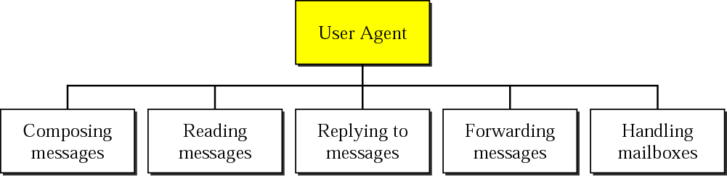
Figure 20.6 User agent
TCP/IP Protocol Suite

Slide 14
Note:
Some examples of command-driven user agents are mail, pine, and elm
TCP/IP Protocol Suite

Slide 15
Note:
Some examples of GUI-based user agents are Eudora, Outlook, and Netscape.
TCP/IP Protocol Suite

Slide 16
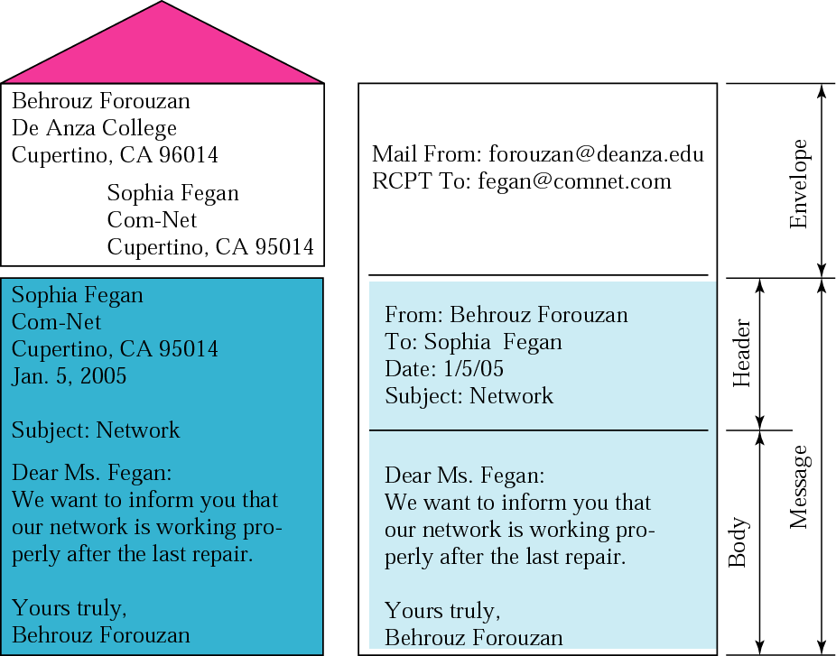
Figure 20.7 Format of an email
TCP/IP Protocol Suite

Slide 17
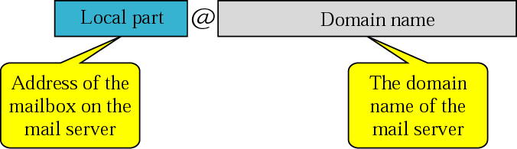
Figure 20.8 Email address
TCP/IP Protocol Suite

Slide 18
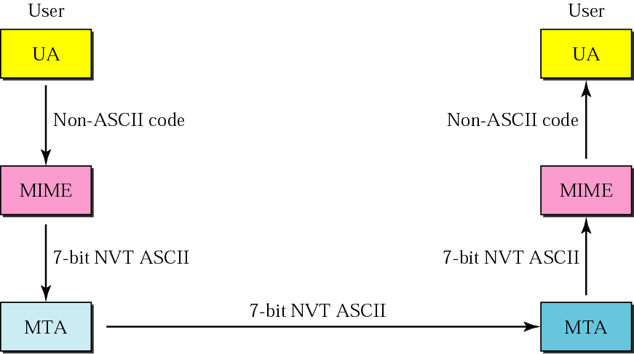
Figure 20.9 MIME
TCP/IP Protocol Suite

Slide 19
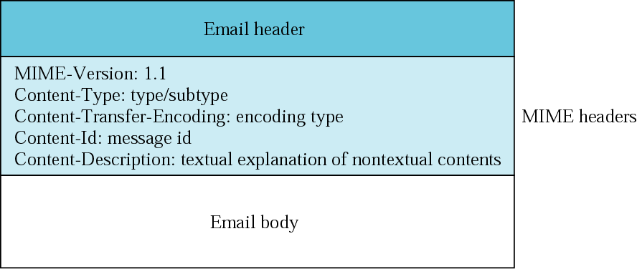
Figure 20.10 MIME header
TCP/IP Protocol Suite

Slide 20
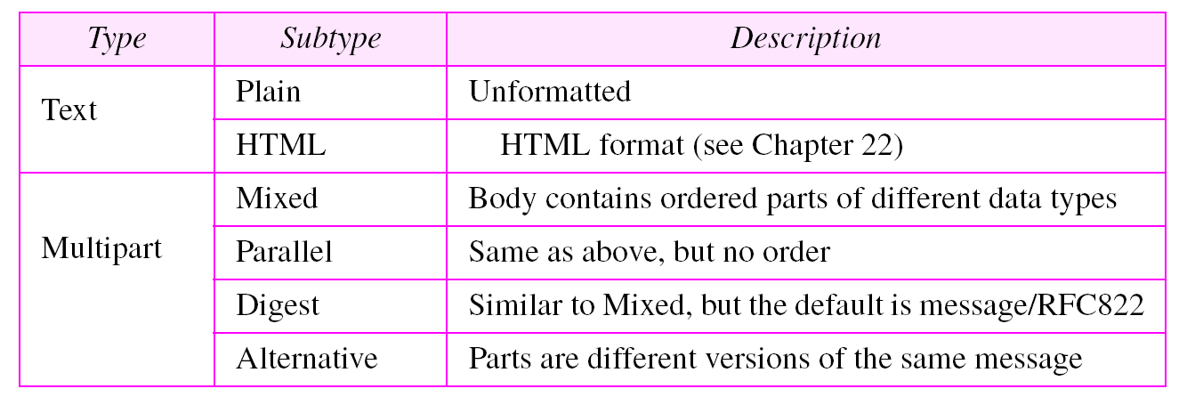
Table 20.1 Data types and subtypes in MIME
TCP/IP Protocol Suite

Slide 21
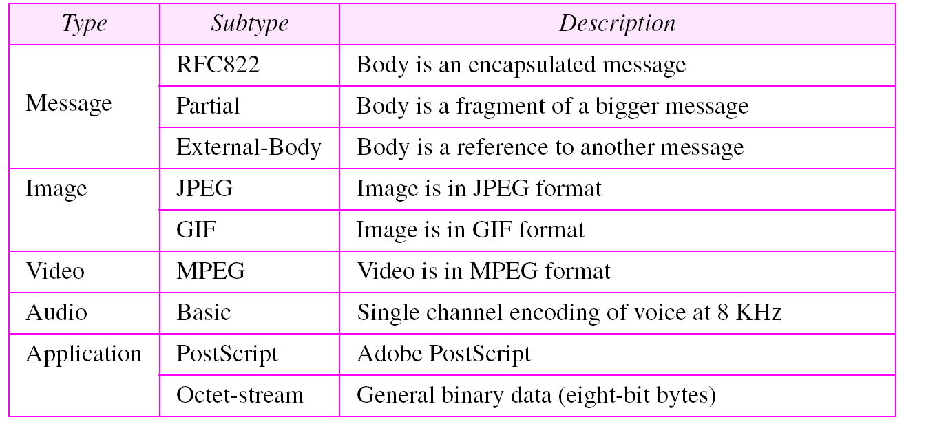
Table 20.1 Data types and subtypes in MIME (Continued)
TCP/IP Protocol Suite

Slide 22
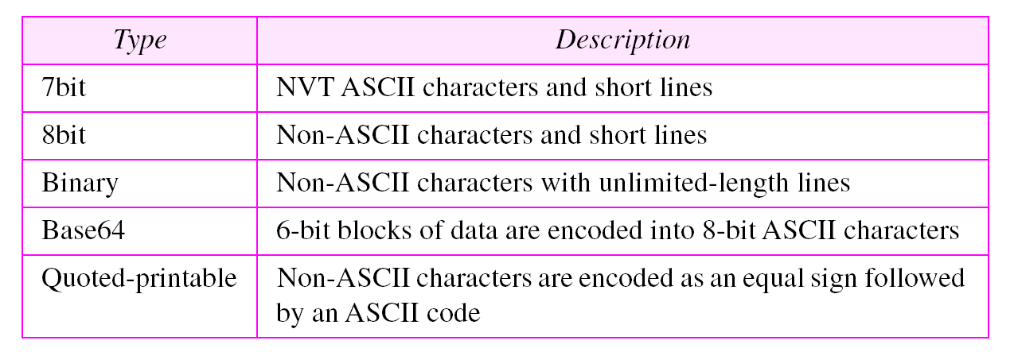
Table 20.2 Content-transfer-encoding
TCP/IP Protocol Suite

Slide 23
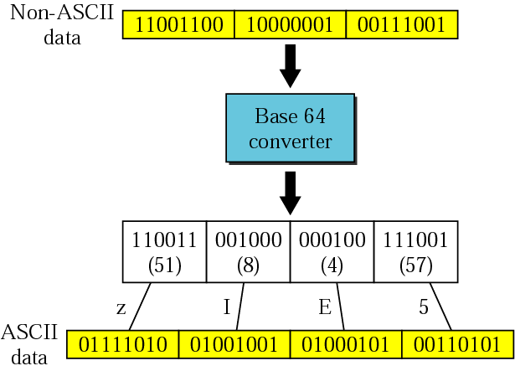
Figure 20.11 Base64
TCP/IP Protocol Suite

Slide 24
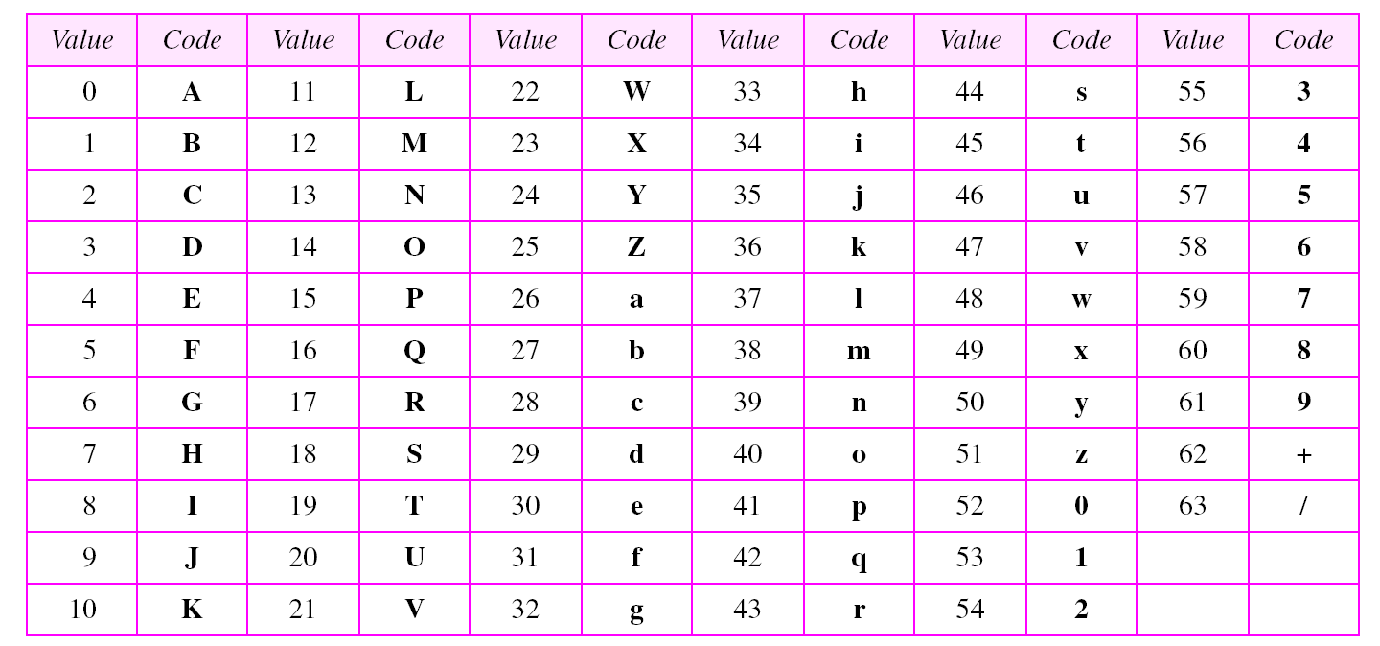
Table 20.3 Base64 encoding table
TCP/IP Protocol Suite

Slide 25
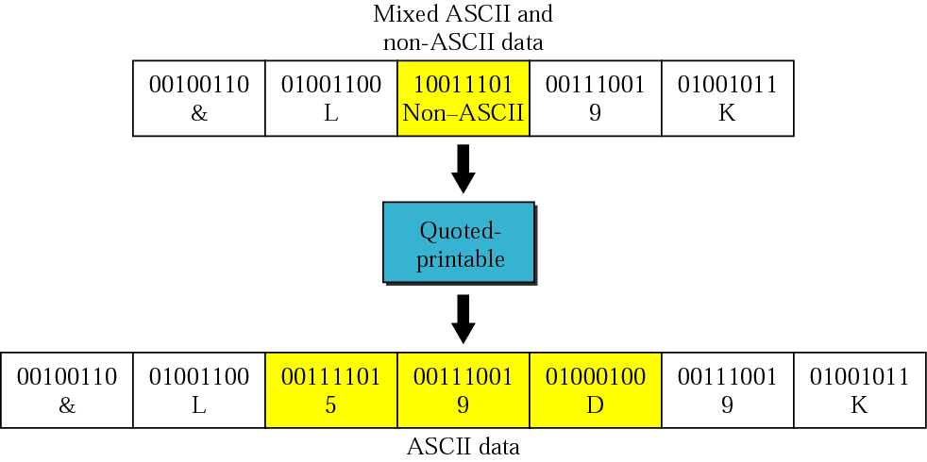
Figure 20.12 Quoted-printable
TCP/IP Protocol Suite

Slide 26
20.3 MESSAGE TRANSFER AGENT:
SMTP
The actual mail transfer requires message transfer agents (MTAs). The protocol that defines the MTA client and server in the Internet is called Simple Mail Transfer Protocol (SMTP).
The topics discussed in this section include:
Commands and Responses
Mail Transfer Phases
TCP/IP Protocol Suite

Slide 27
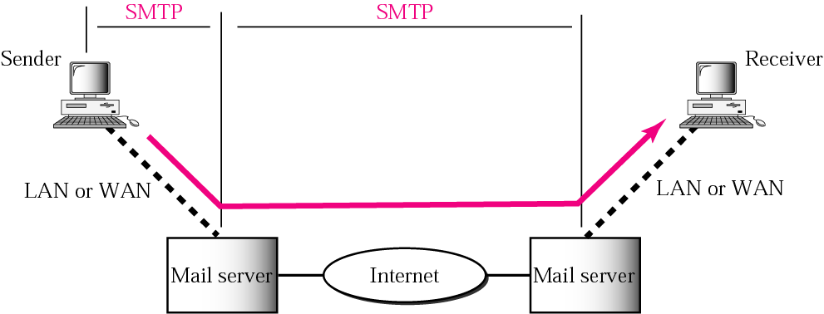
Figure 20.13 SMTP range
TCP/IP Protocol Suite

Slide 28
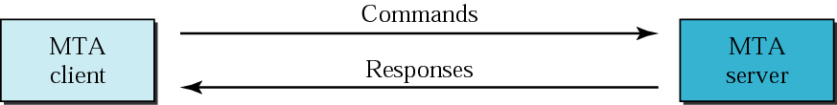
Figure 20.14 Commands and responses
TCP/IP Protocol Suite

Slide 29

Figure 20.15 Command format
TCP/IP Protocol Suite

Slide 30
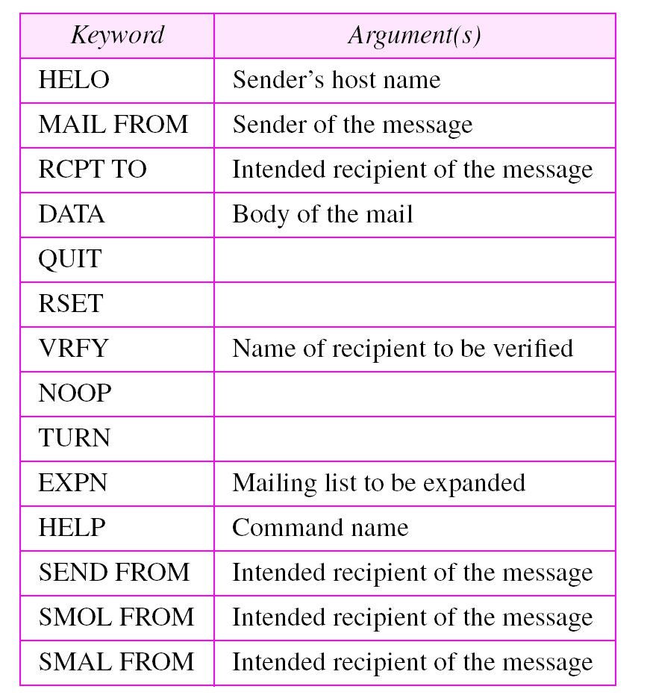
Table 20.4 Commands
TCP/IP Protocol Suite

Slide 31
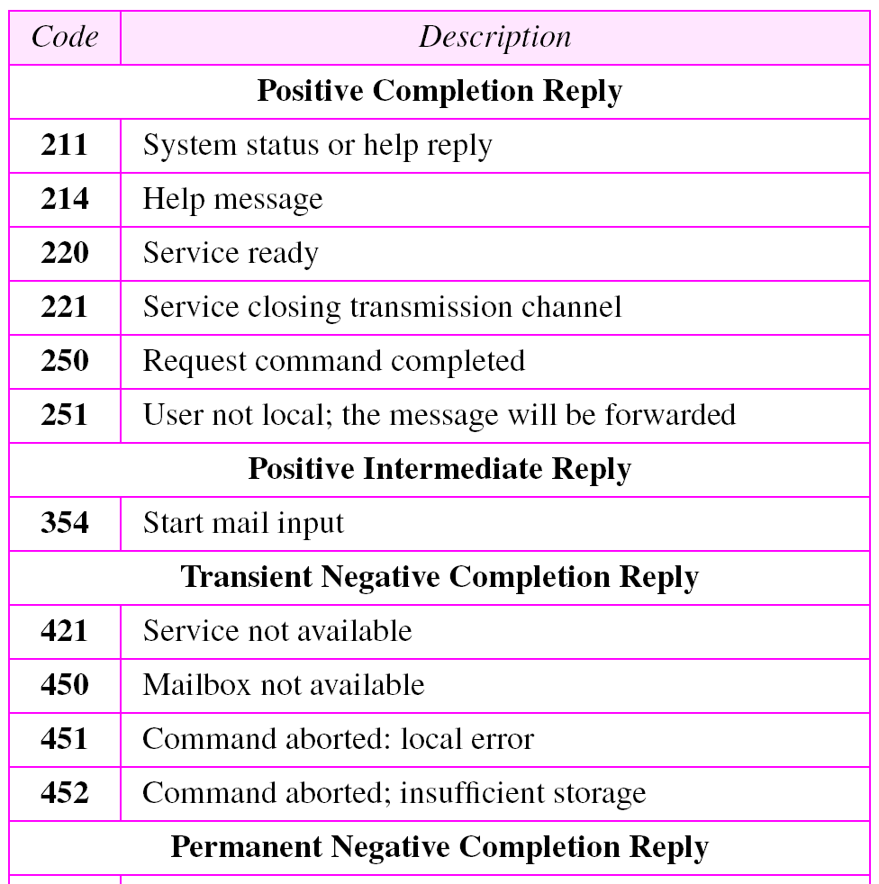
Table 20.5 Responses
TCP/IP Protocol Suite

Slide 32
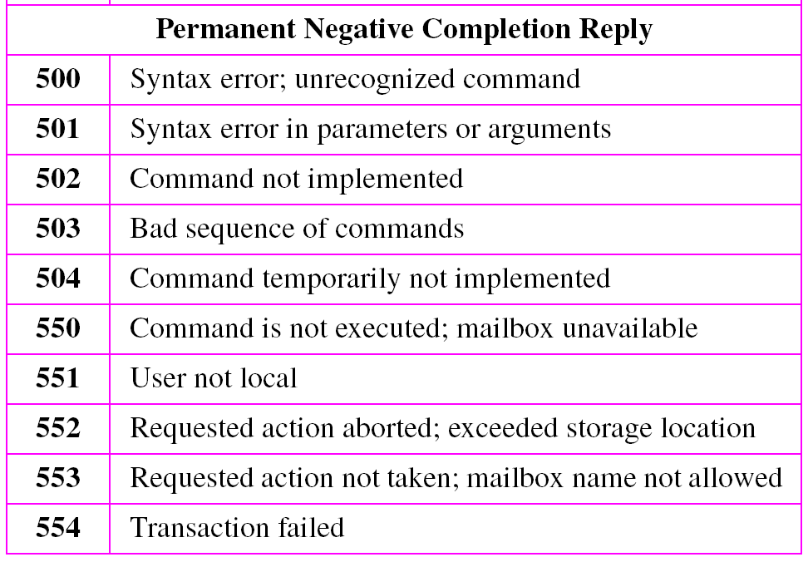
Table 20.5 Responses (Continued)
TCP/IP Protocol Suite

Slide 33
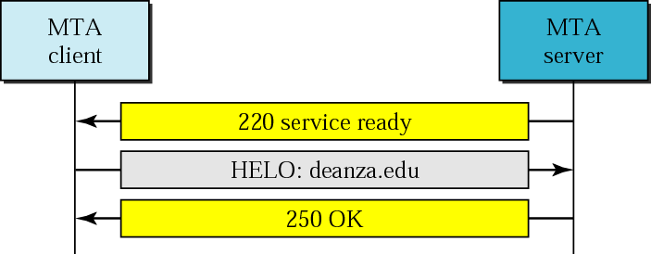
Figure 20.16 Connection establishment
TCP/IP Protocol Suite

Slide 34
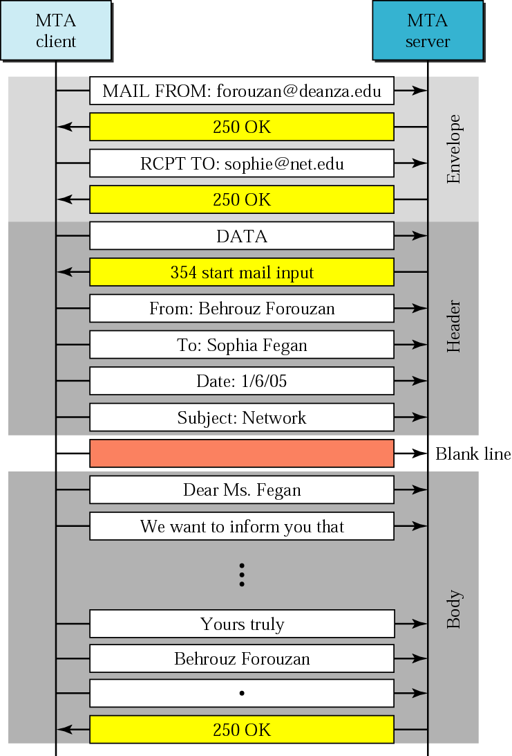
Figure 20.17 Message transfer
TCP/IP Protocol Suite

Slide 35
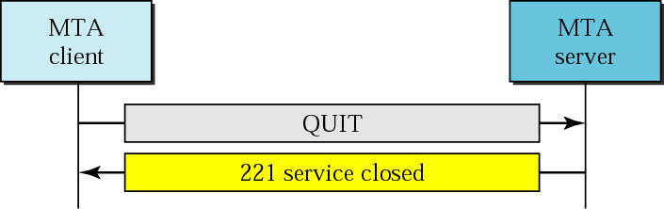
Figure 20.18 Connection termination
TCP/IP Protocol Suite

Slide 36
Example 1
Let us see how we can directly use SMTP to send an email and simulate the commands and responses we described in this section. We use TELNET to log into port 25 (the well-known port for SMTP). We then use the commands directly to send an email. In this example, forouzanb@adelphia.net is sending an email to himself. The first few lines show TELNET trying to connect to the adelphia mail server.
$ telnet mail.adelphia.net 25
Trying 68.168.78.100...
Connected to mail.adelphia.net (68.168.78.100).
After connection, we can type the SMTP commands and then receive the responses as shown below. We have shown the commands in black and the responses in color. Note that we have added for clarification some comment lines, designated by the “=” sign. These lines are not part of the email procedure.
TCP/IP Protocol Suite

Slide 37
Example 1 (Continued)
================== Connection Establishment ================
220 mta13.adelphia.net SMTP server ready Fri, 6 Aug 2004 . . .
HELO mail.adelphia.net
250 mta13.adelphia.net
===================== Envelope ===================
MAIL FROM: forouzanb@adelphia.net
250 Sender <forouzanb@adelphia.net> Ok
RCPT TO: forouzanb@adelphia.net
250 Recipient <forouzanb@adelphia.net> Ok
=================== Header and Body ==================
DATA
354 Ok Send data ending with <CRLF>.<CRLF>
From: Forouzan
TO: Forouzan
This is a test message
to show SMTP in action.
.
TCP/IP Protocol Suite

Slide 38
Example 1 (Continued)
============= Connection Termination===============
250 Message received: adelphia.net@mail.adelphia.net
QUIT
221 mta13.adelphia.net SMTP server closing connection
Connection closed by foreign host.
TCP/IP Protocol Suite

Slide 39
20.4 MESSAGE ACCESS AGENT:
POP AND IMAP
The third stage of mail delivery uses a message access agent; the client must pull messages from the server. Currently two message access protocols are available: Post Office Protocol, version 3 (POP3) and Internet Mail Access Protocol, version 4.
The topics discussed in this section include:
POP3
IMAP4
TCP/IP Protocol Suite

Slide 40
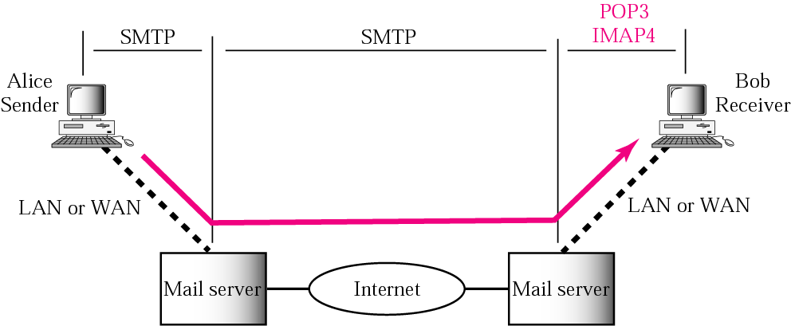
Figure 20.19 POP3 and IMAP4
TCP/IP Protocol Suite

Slide 41
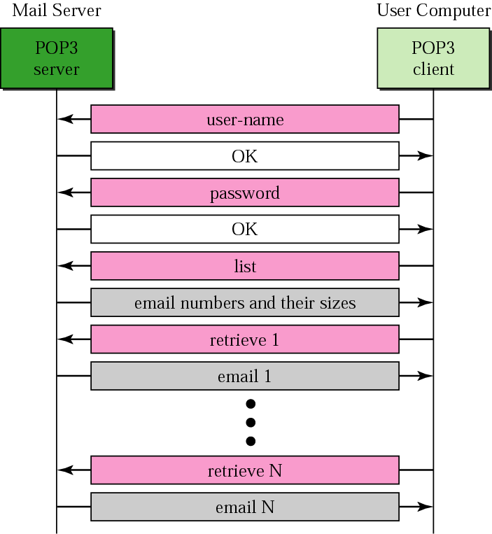
Figure 20.20 POP3
TCP/IP Protocol Suite

Slide 42
20.5 WEB-BASED MAIL
Some websites such as Hotmail and Yahoo provide email service to anyone who accesses the site. Mail transfer and retrieval requires the use of HTTP.
TCP/IP Protocol Suite

